Slide 1

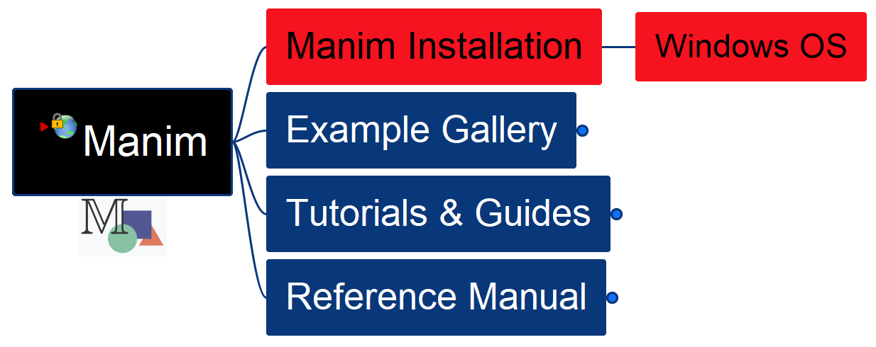

Learn Manim Library by Practice – Opening and Installation
001

Slide 2
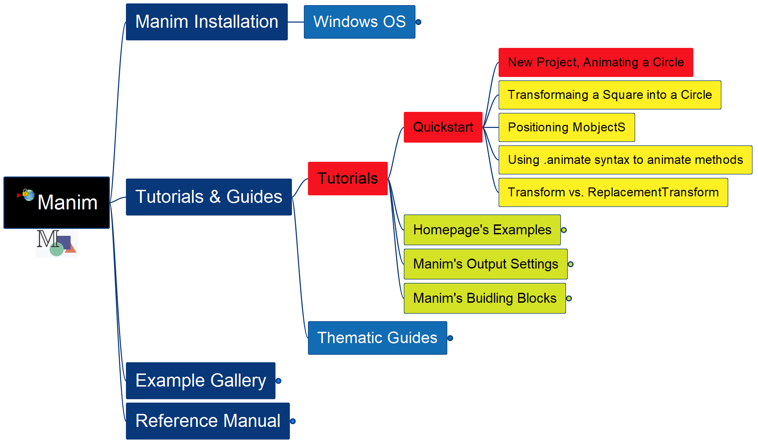
Learning Manim
002
Tutorial – QuickStart – New Project

Slide 3
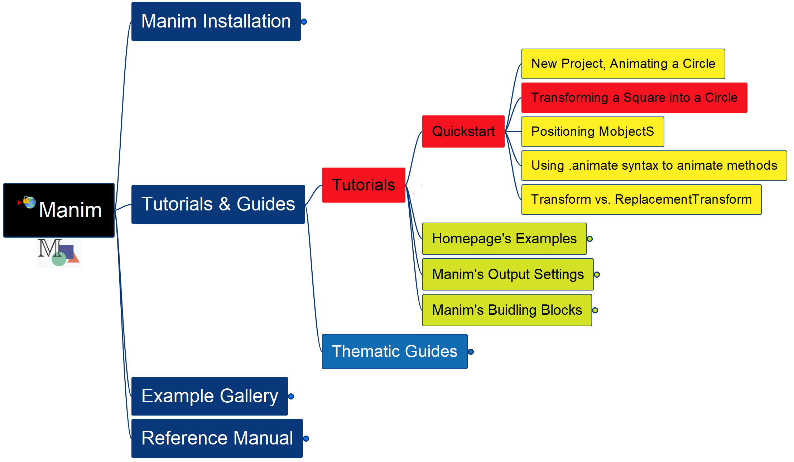
Learning Manim
003
Transform a Square into a Circle

Slide 4
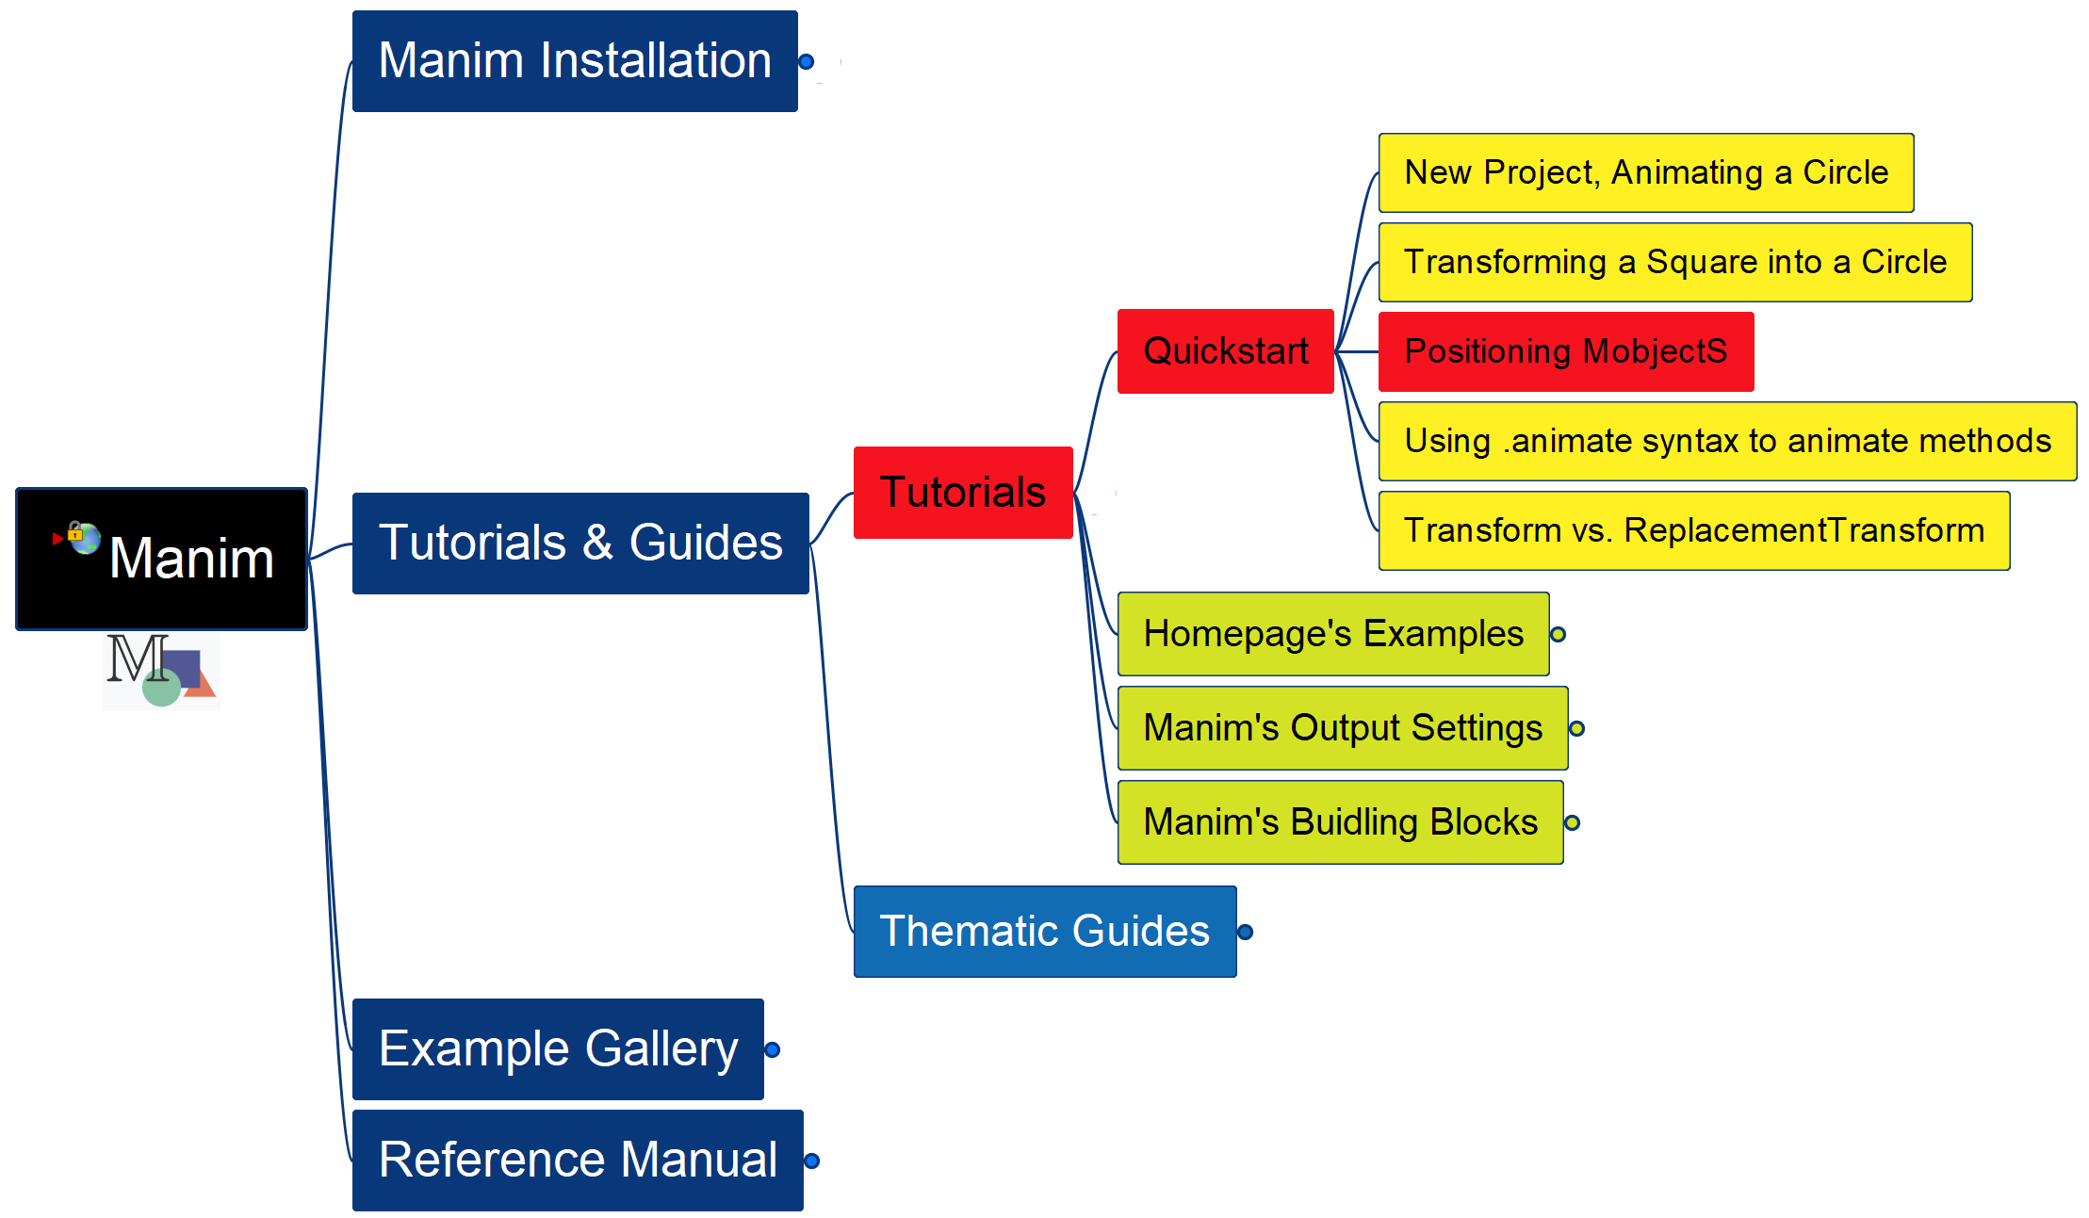
Learning Manim
004
Positioning MobjectS

Slide 5
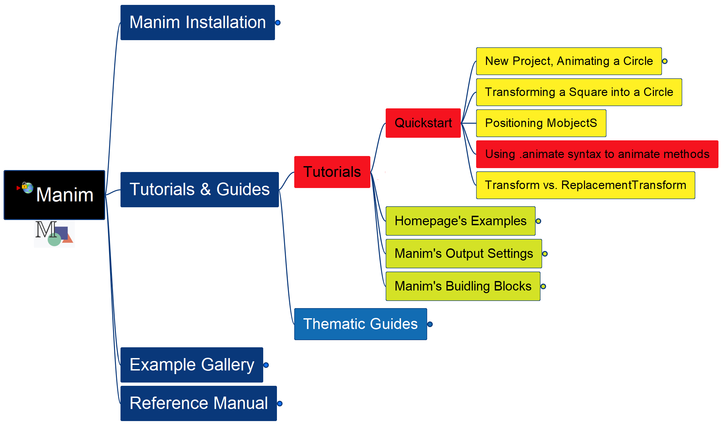
Learning Manim
005
Using .animate syntax

Slide 6
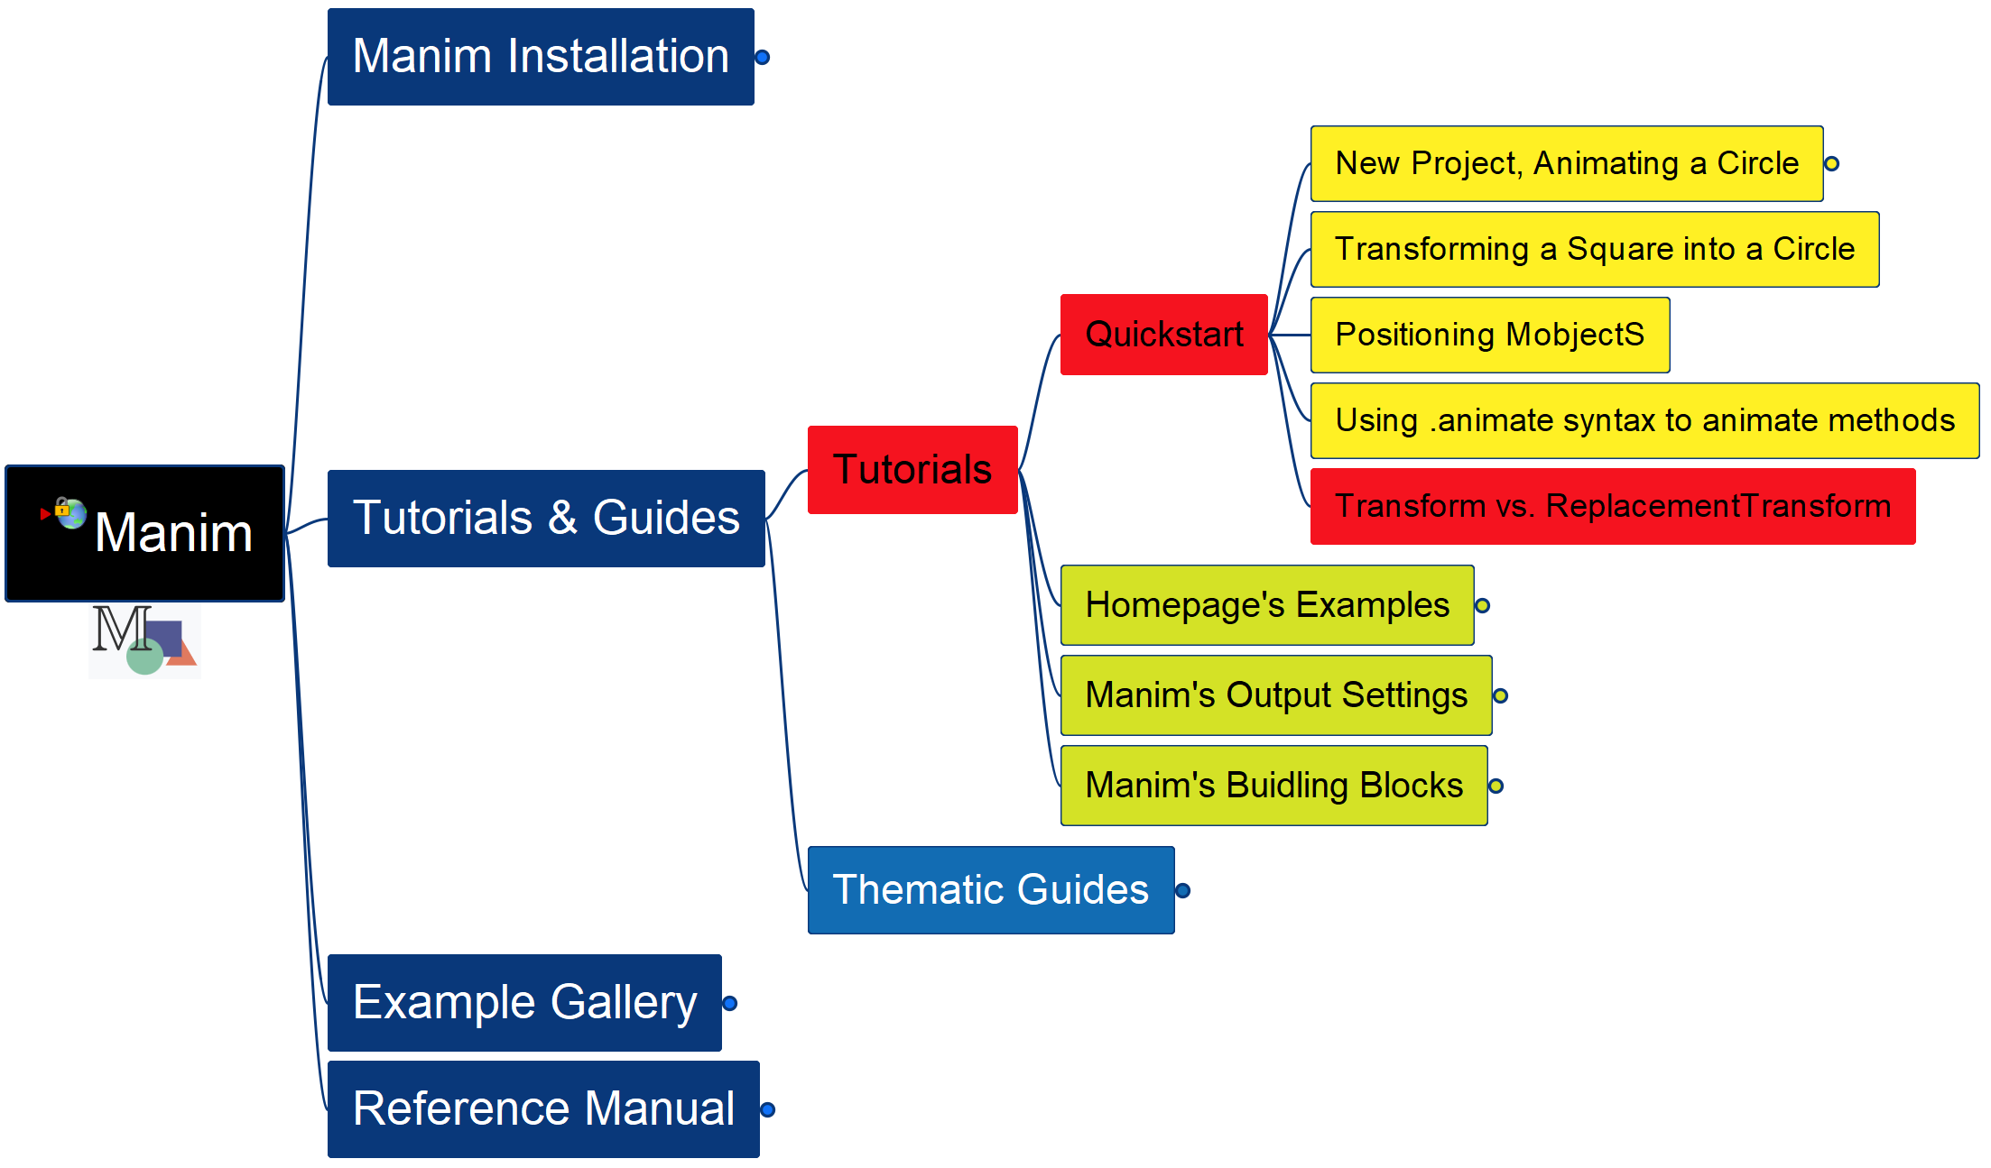
Learning Manim
006
Transform vs. ReplacementTransform

Slide 7
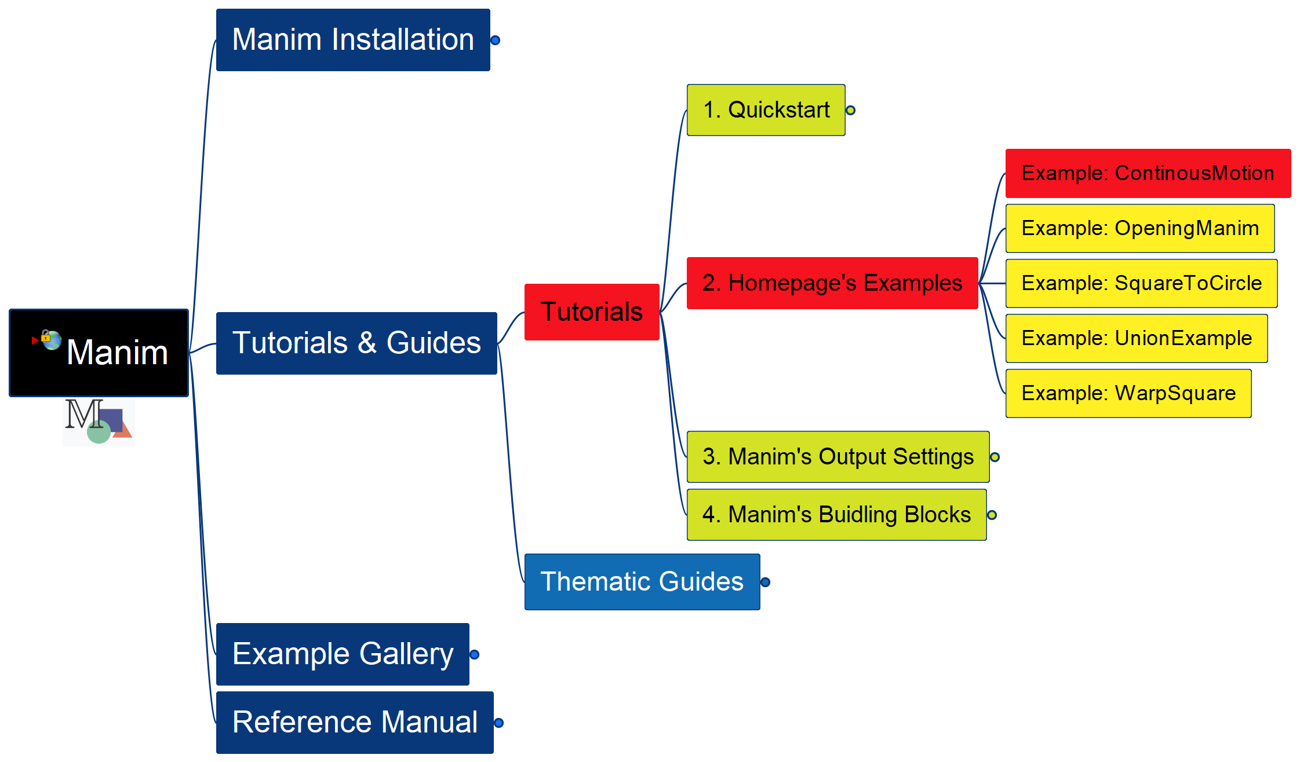
Learning Manim
007
Example: Continuous Motion

Slide 8
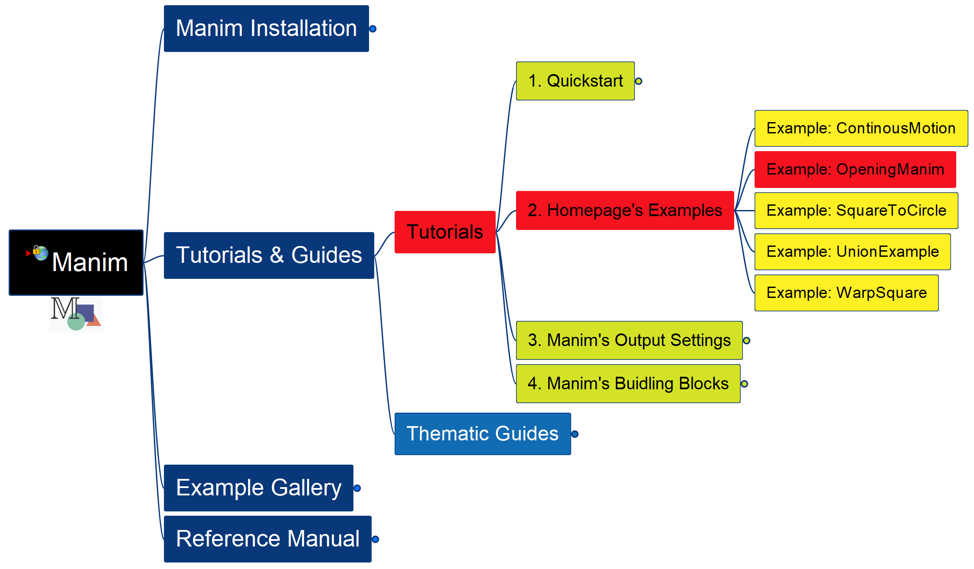
Learning Manim
Example: Opening Manim
008

Slide 9
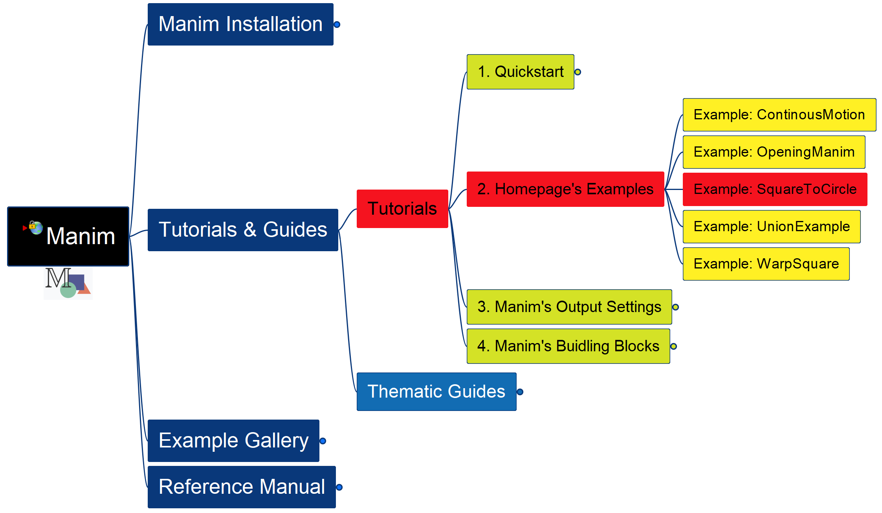
Learning Manim
Example: Square To Circle
009

Slide 10
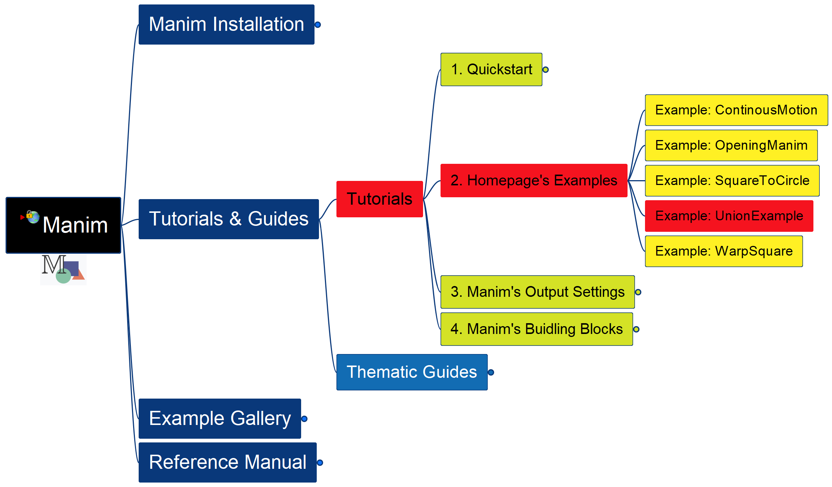
Learning Manim
Example: Union
010

Slide 11
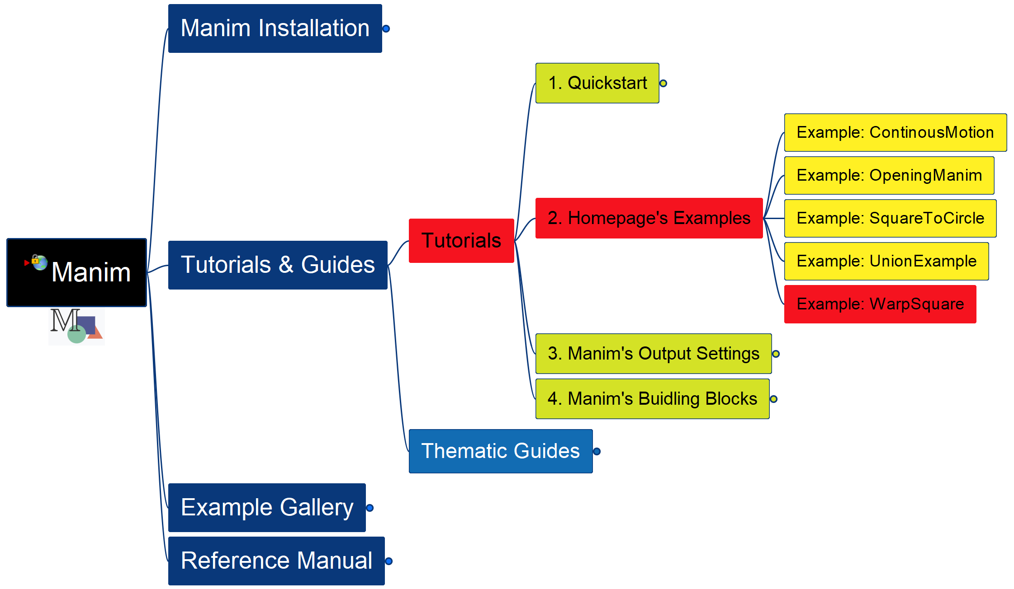
Learning Manim
Example: Warp Square
011

Slide 12
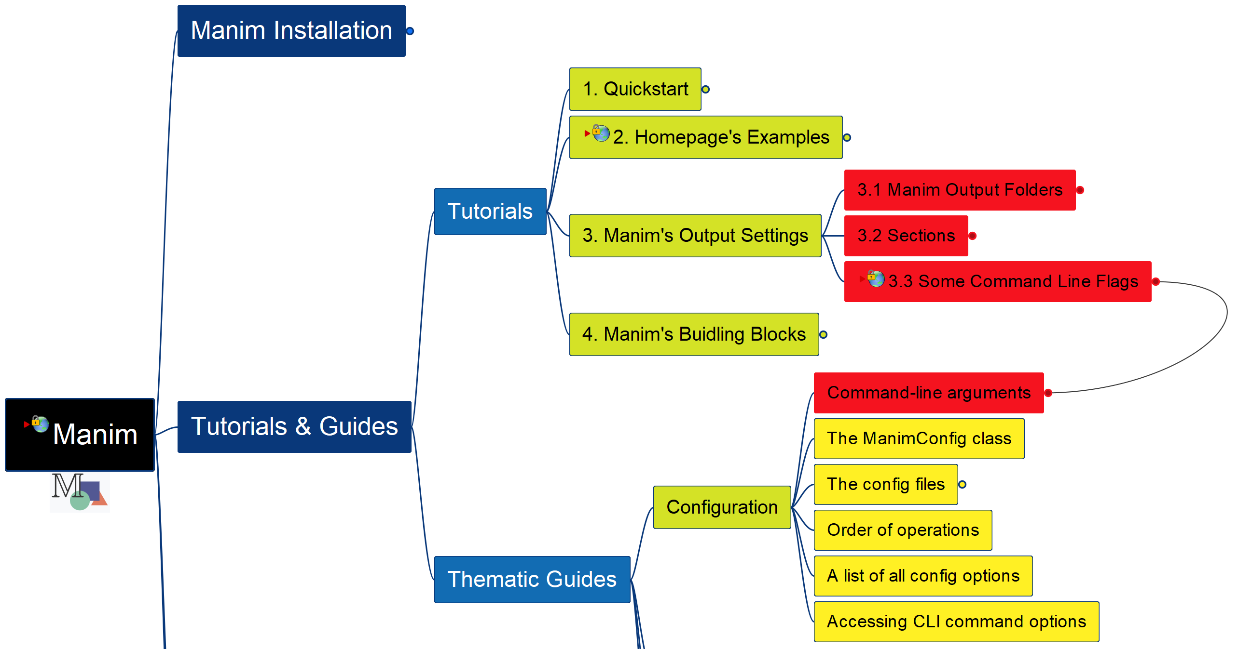
Learning Manim
Manim’s Output Settings
012

Slide 13
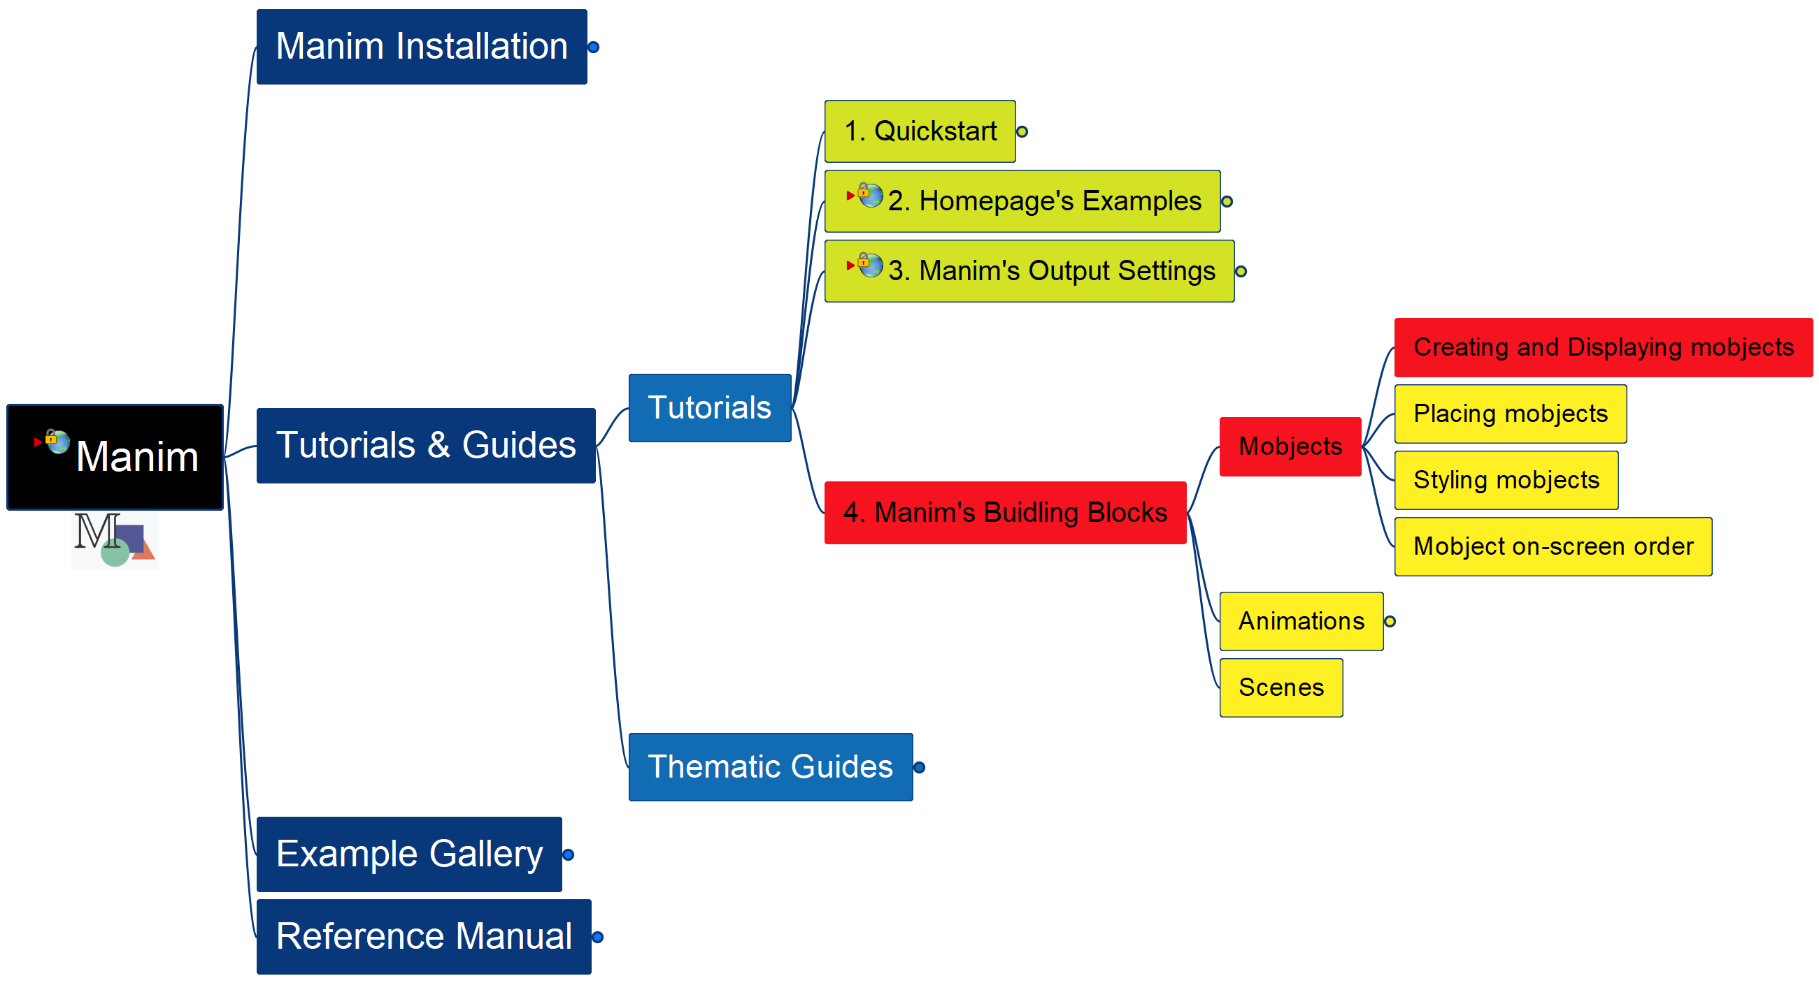
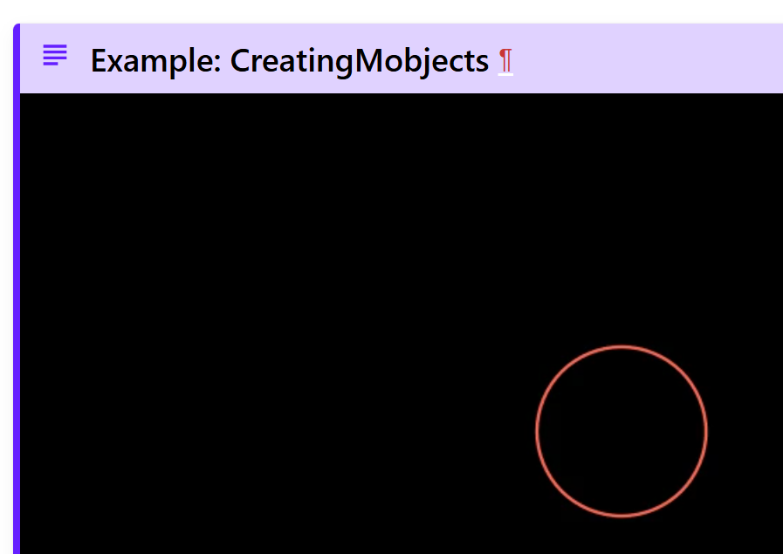
Learning Manim
Building Block – Mobjects – Create and Display
013

Slide 14
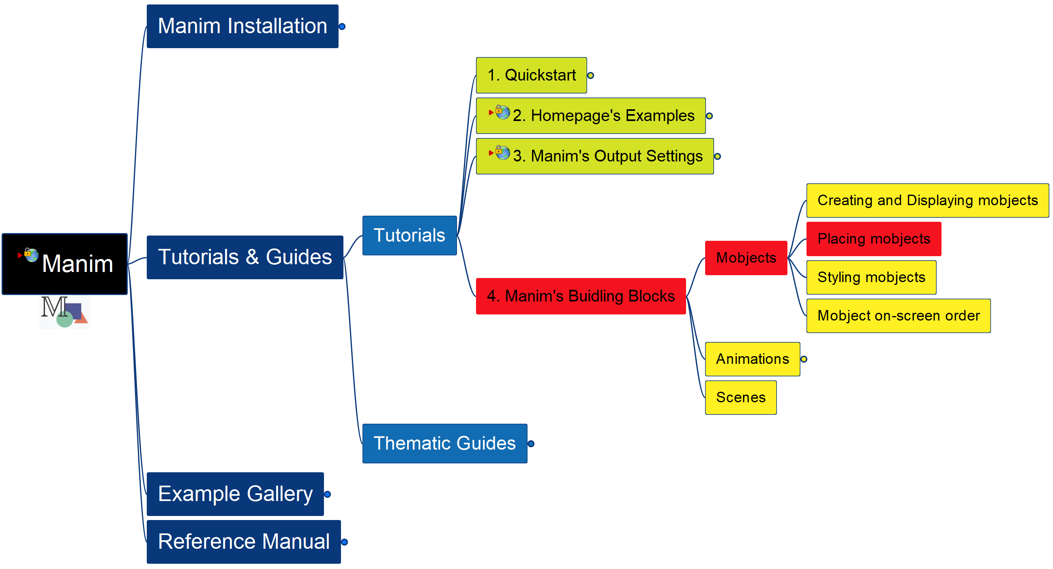
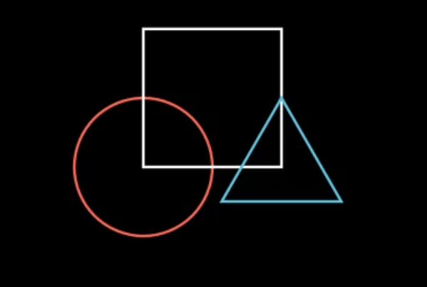
Learning Manim
Building Block – Mobjects – Placing
014

Slide 15
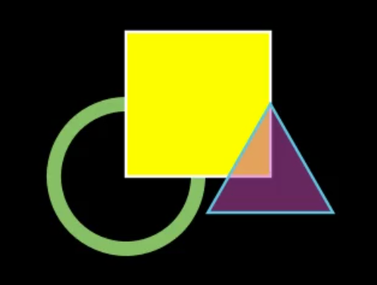
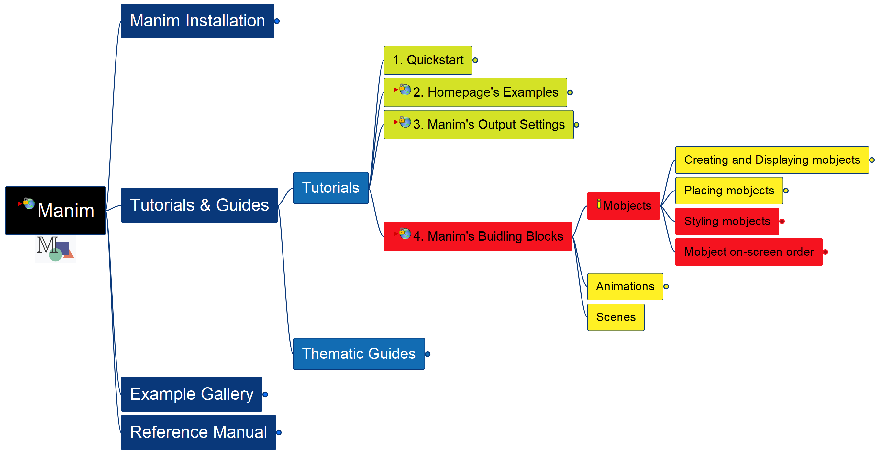
Learning Manim
Building Block – Mobjects – Styling, Ordering
015

Slide 16
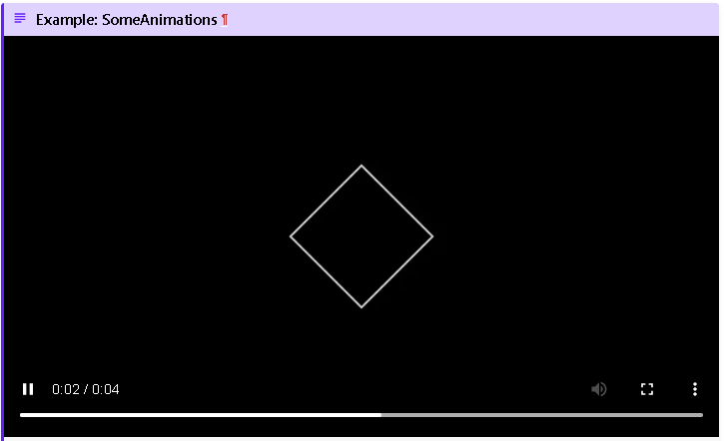
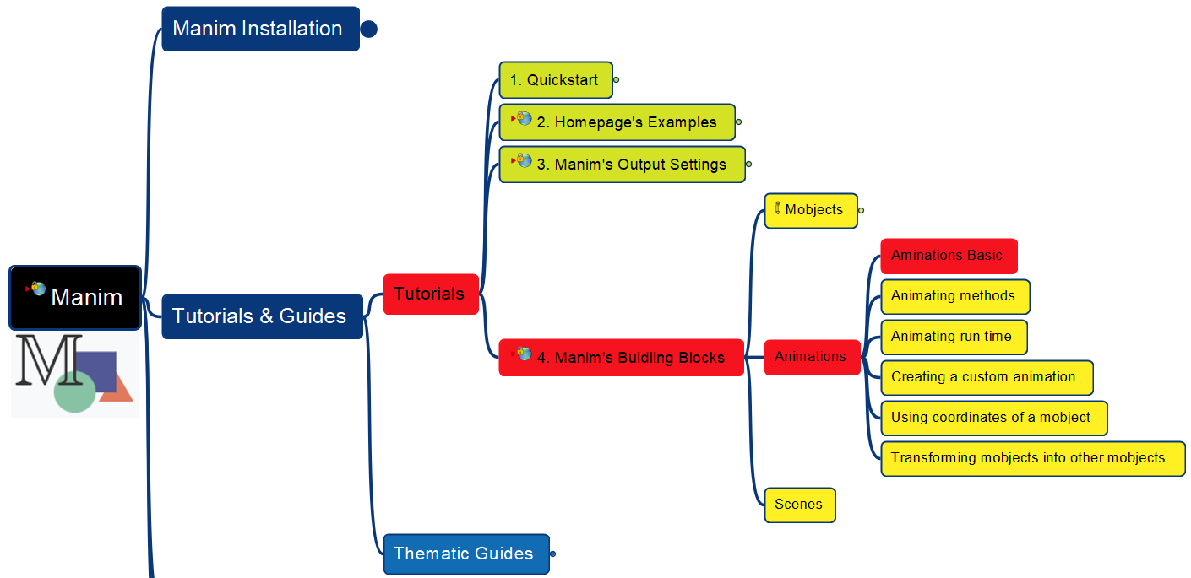
Learning Manim
Building Block – Animations - Basics
016
Reinstall Manim

Slide 17
Learning Manim
Building Block – Animations - Basics
017

Slide 18
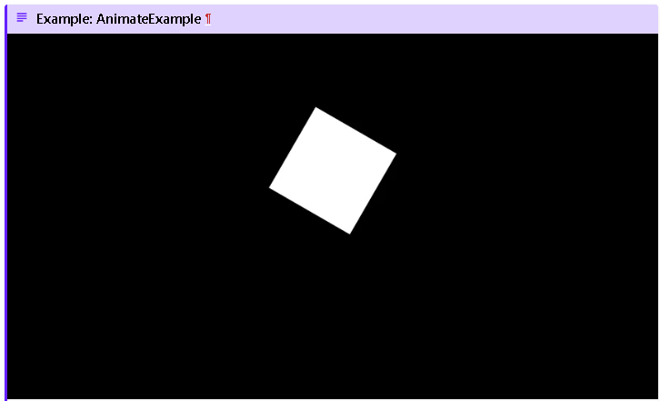
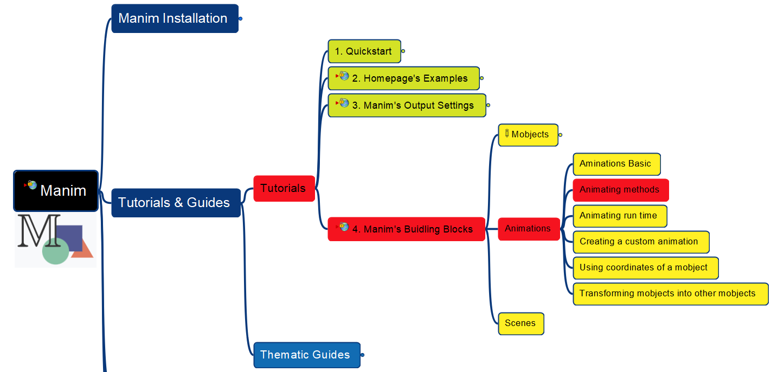
Learning Manim
Building Block – Animations - Methods
018

Slide 19
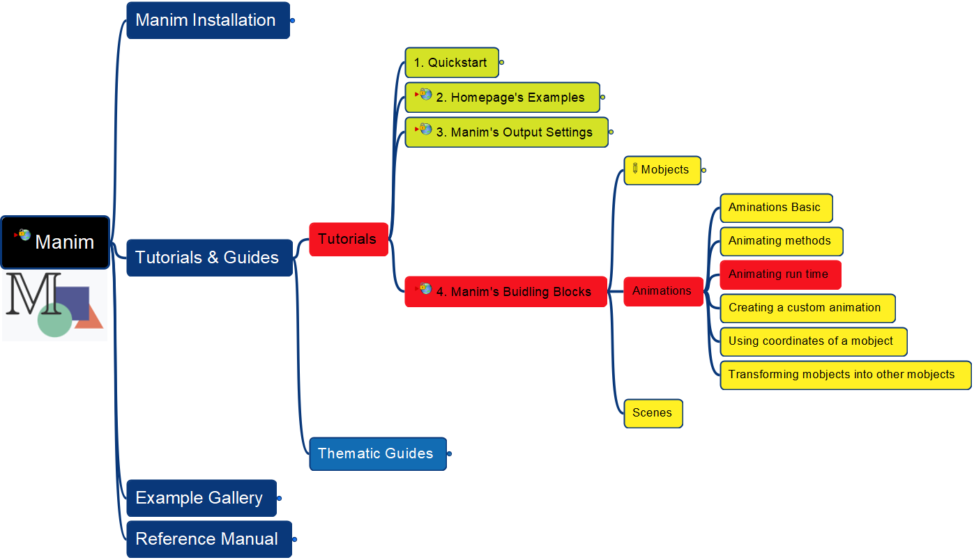
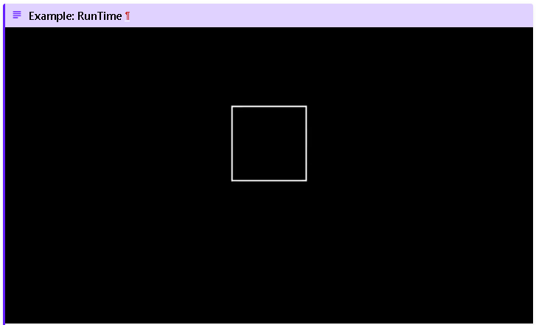
Learning Manim
Building Block – Animations – Run Time
019

Slide 20
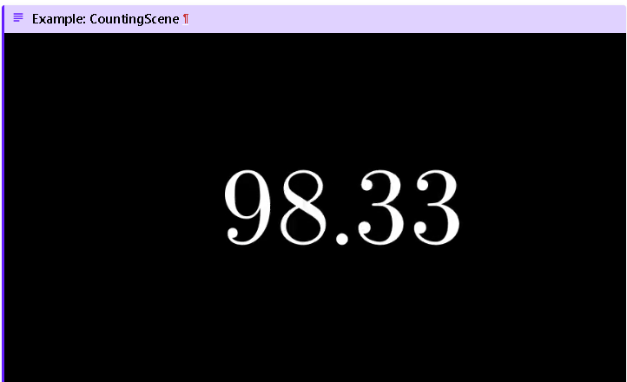
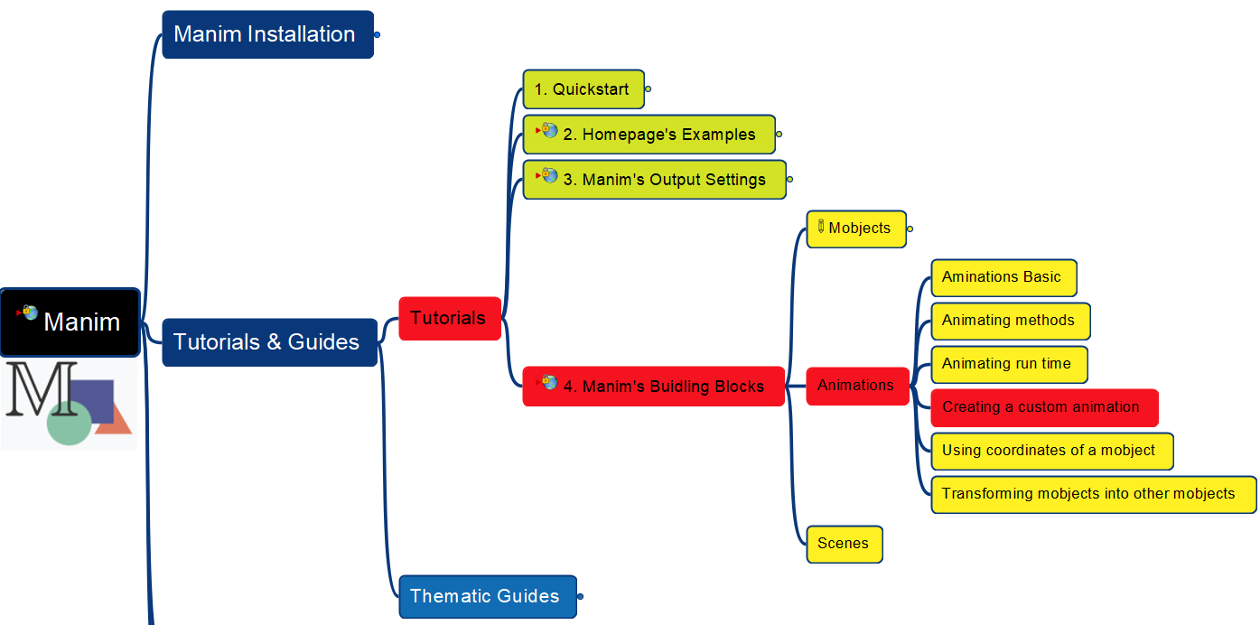
Learning Manim
Building Block – Animations – Customize
020
Missing LaTex

Slide 21
Learning Manim
Building Block – Animations – Customize
021
Continue…

Slide 22
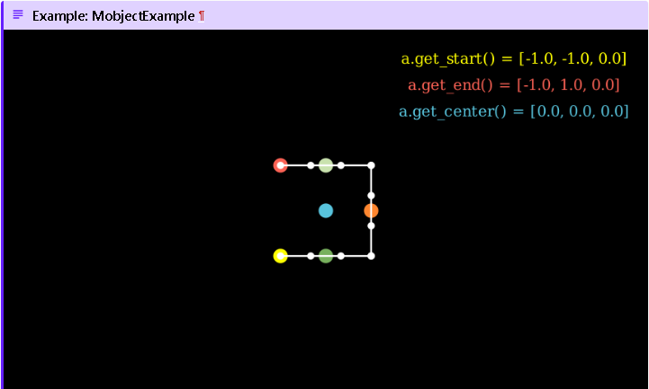
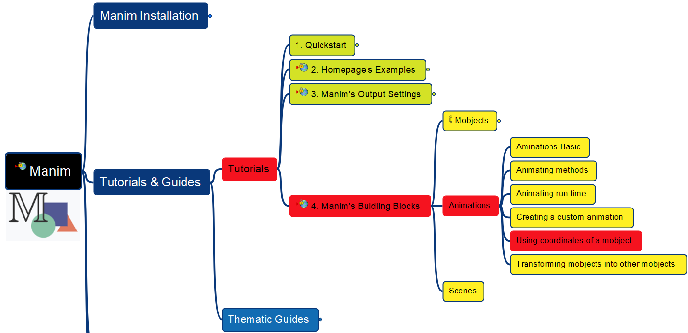
Learning Manim
Building Block – Animations – Use Coordinates
022

Slide 23
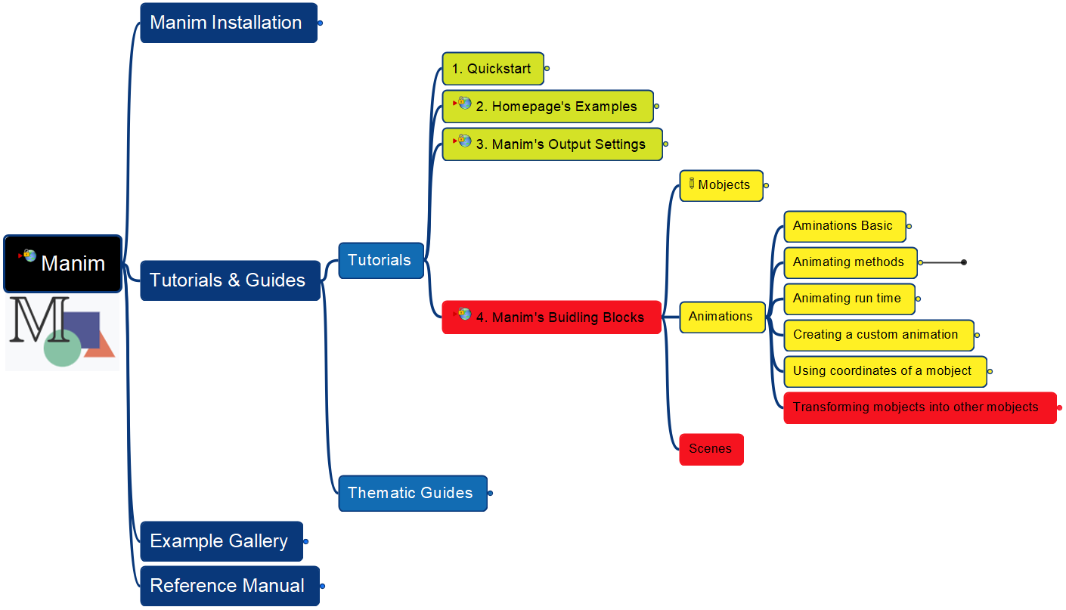
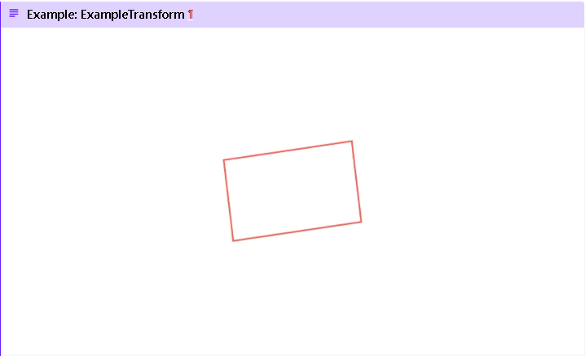
Learning Manim
Building Block – Animations – Transforming
Building Block – Scenes
023

Slide 24
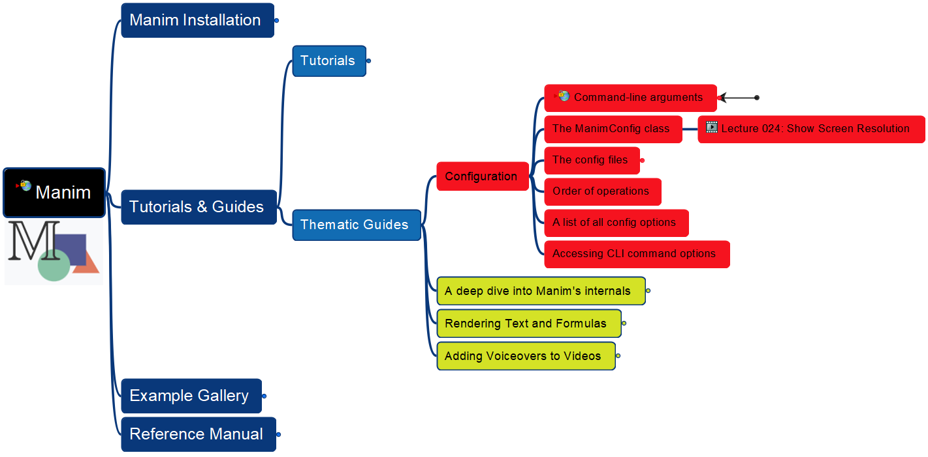
Learning Manim
Thematic Guides – Configuration
024

Slide 25
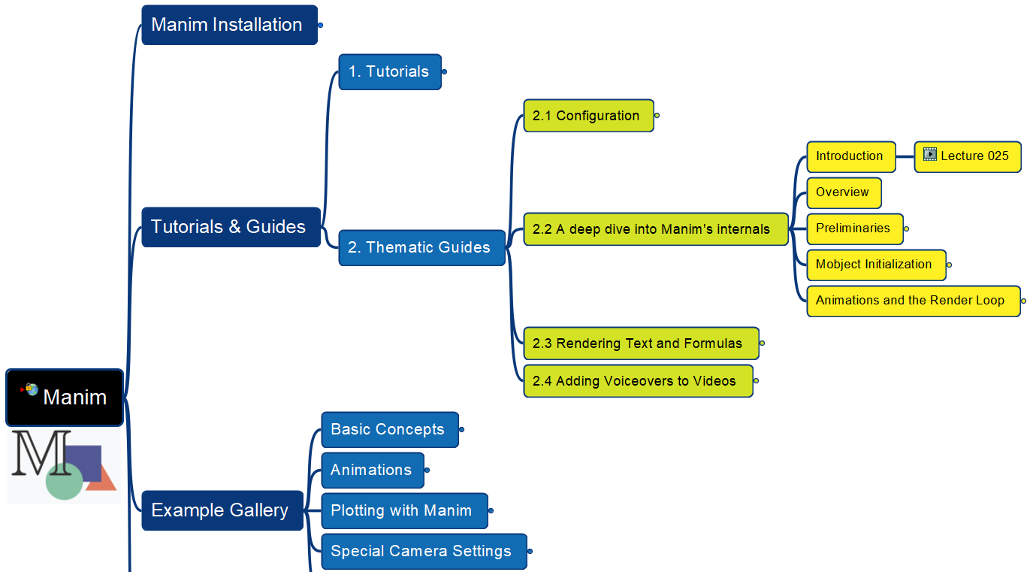

Learning Manim
Thematic Guides – Deep Dive - Introduction
025

Slide 26
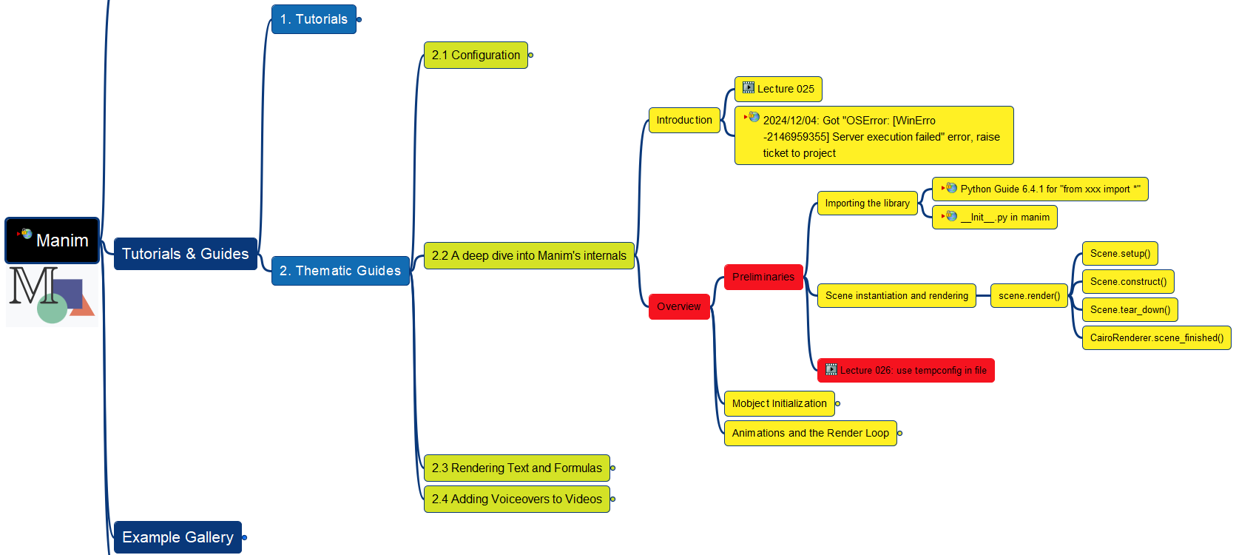
Learning Manim
Thematic Guides – Deep Dive - Preliminaries
026

Slide 27
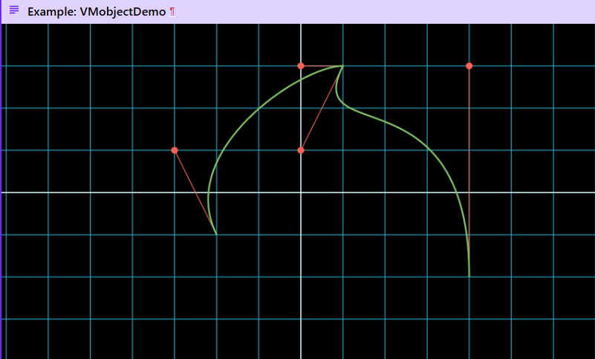
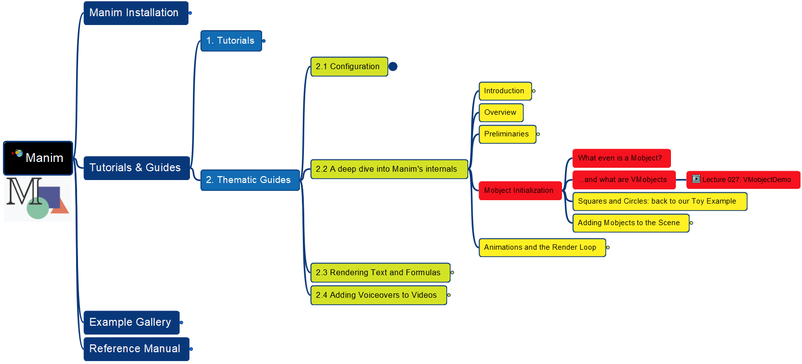
Learning Manim
Thematic Guides – Deep Dive - VMobject
027

Slide 28
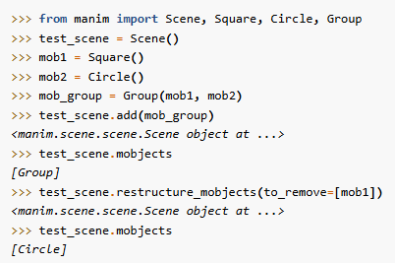
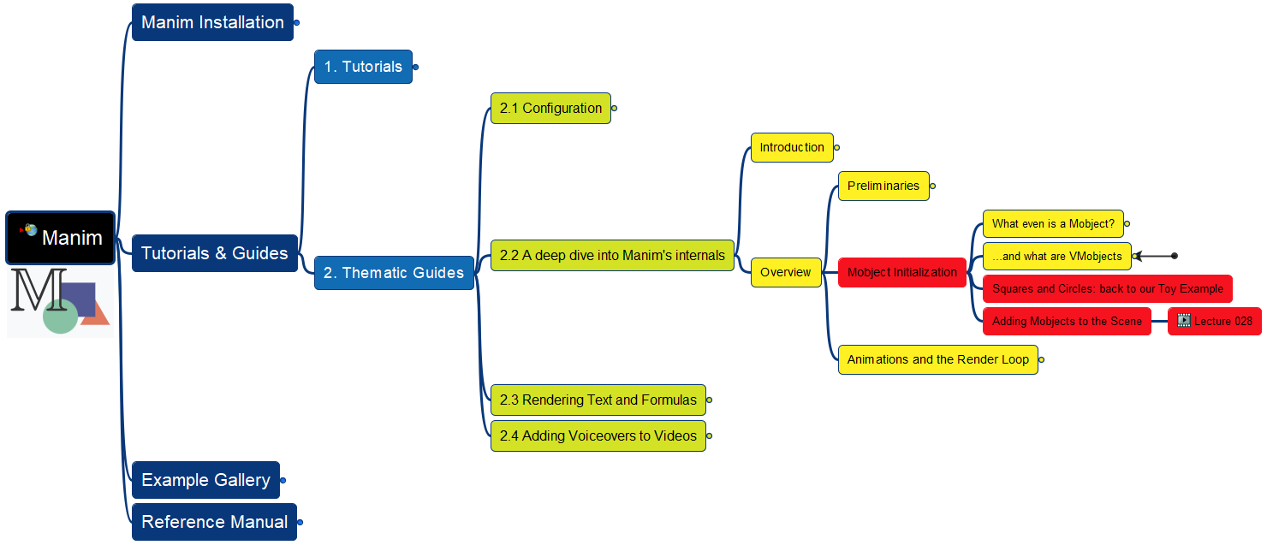
Learning Manim
Thematic Guides – Deep Dive – Mobject Initial
028

Slide 29
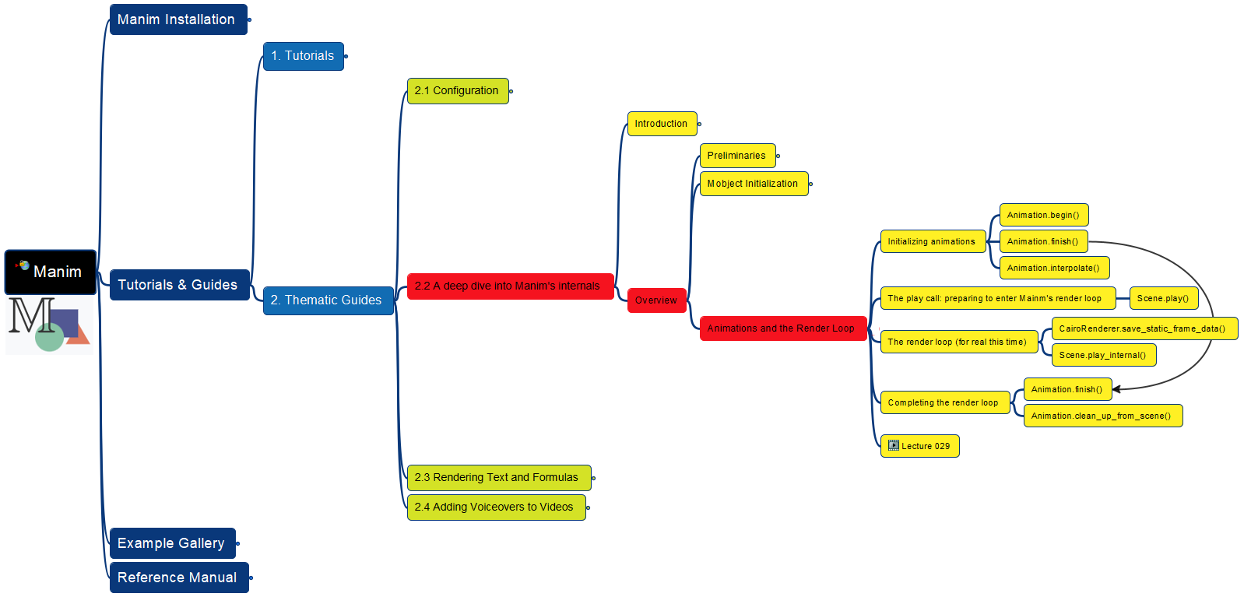
Learning Manim
Thematic Guides – Deep Dive
– Animations and Render Loop
029

Slide 30
Animations and Render Loop
Animation.begin()
Scene.play()
CairoRenderer.save_static_frame_data()
Scene.play_internal()
Camera
SceneFileWriter
Animation.finish()
Animation.clean_up_from_scene()
Scene.wait()
Scene.construct()
Scene.tear_down()
SceneFileWriter.finish()

Slide 31
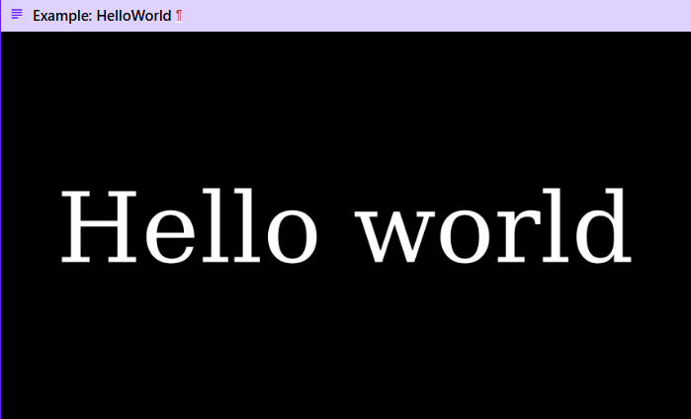
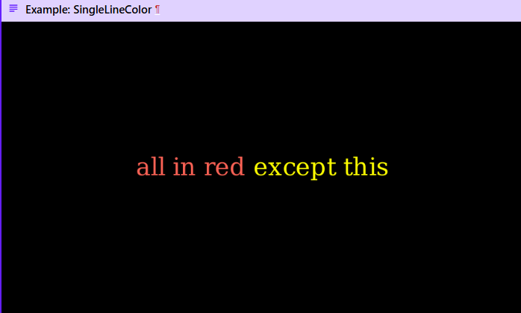
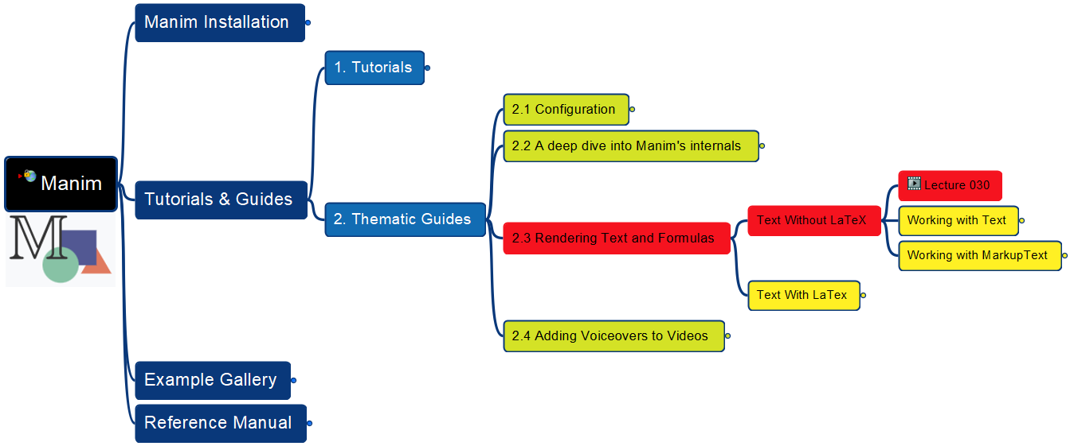
Learning Manim
Thematic Guides – Rendering Text and Formulas – Text Without LaTeX - Overview
030

Slide 32
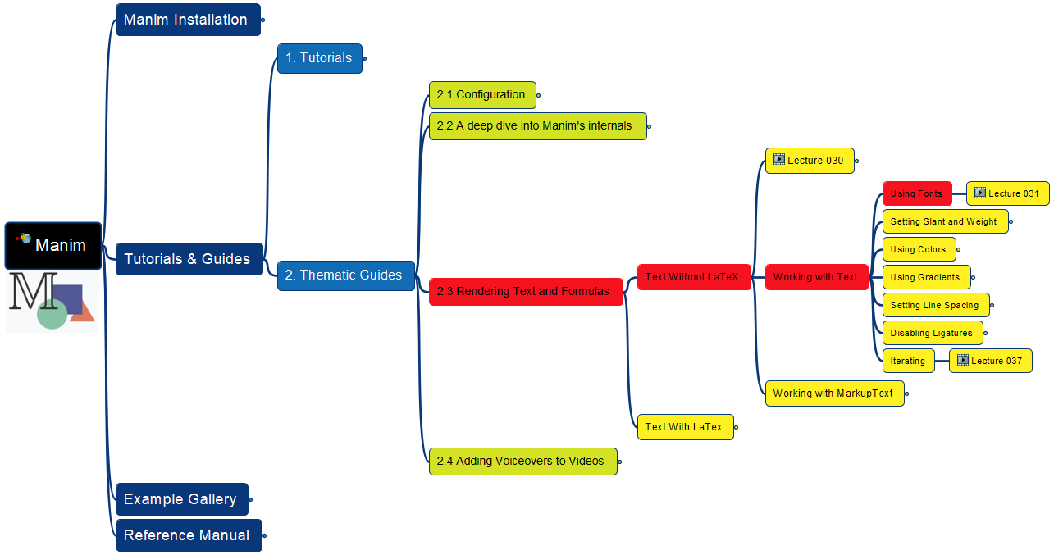
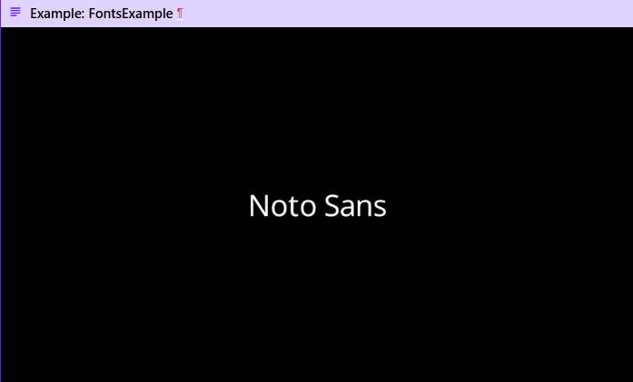
Learning Manim
Thematic Guides – Rendering Text and Formulas – Text Without LaTeX – Text – Using Fonts
031

Slide 33
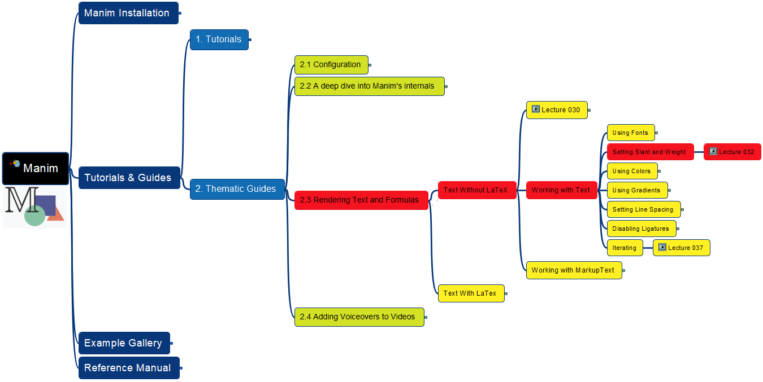
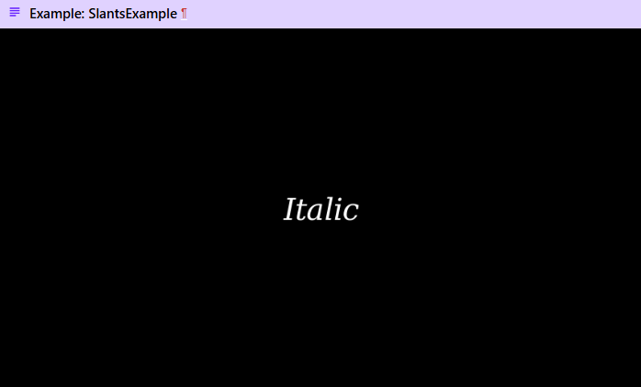
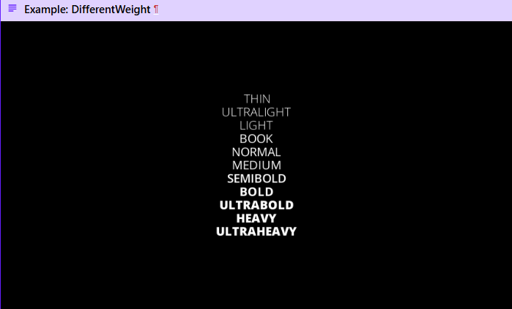
Learning Manim
Thematic Guides – Rendering Text and Formulas – Text Without LaTeX – Text – Setting Slant & Weight
032

Slide 34
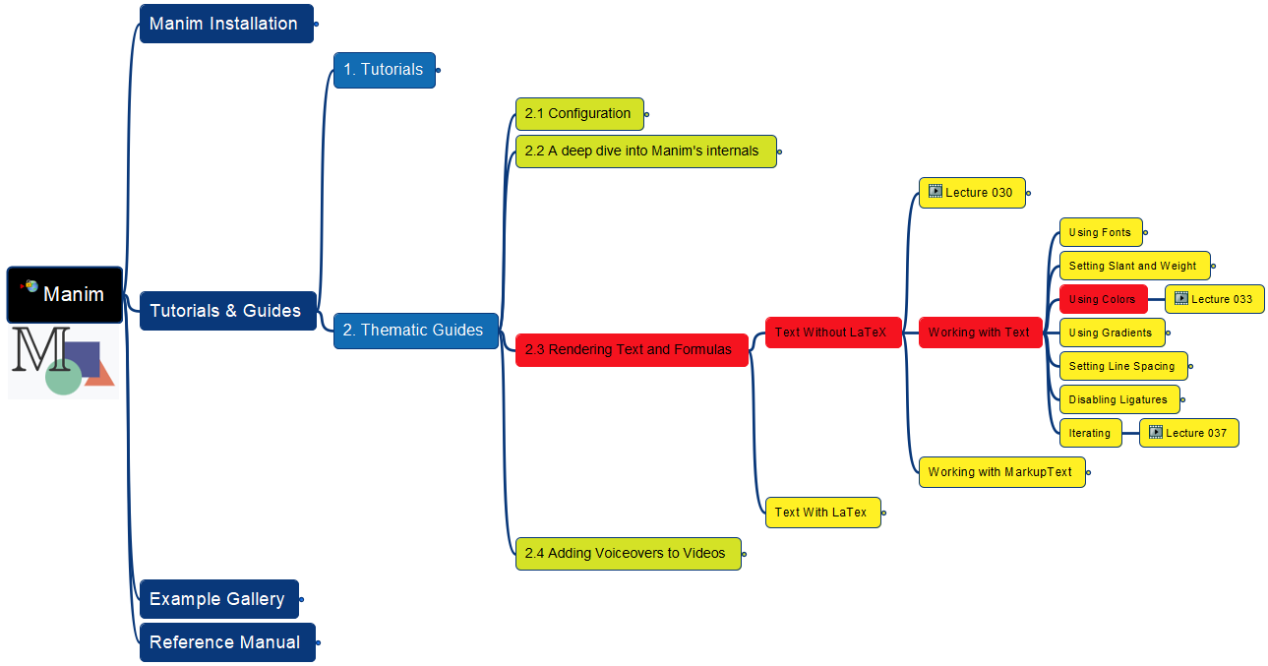
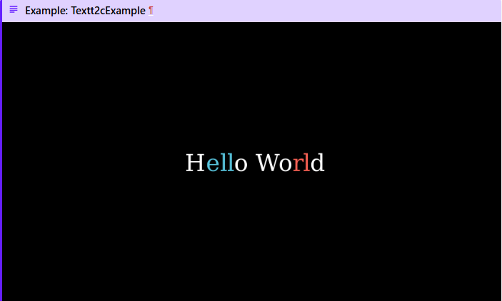
Learning Manim
Thematic Guides – Rendering Text and Formulas – Text Without LaTeX – Text – Using Colors
033

Slide 35
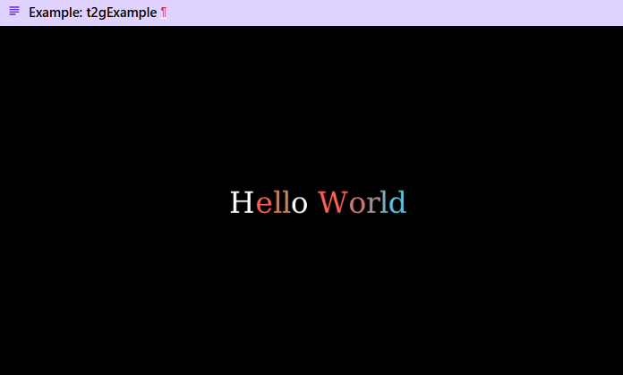
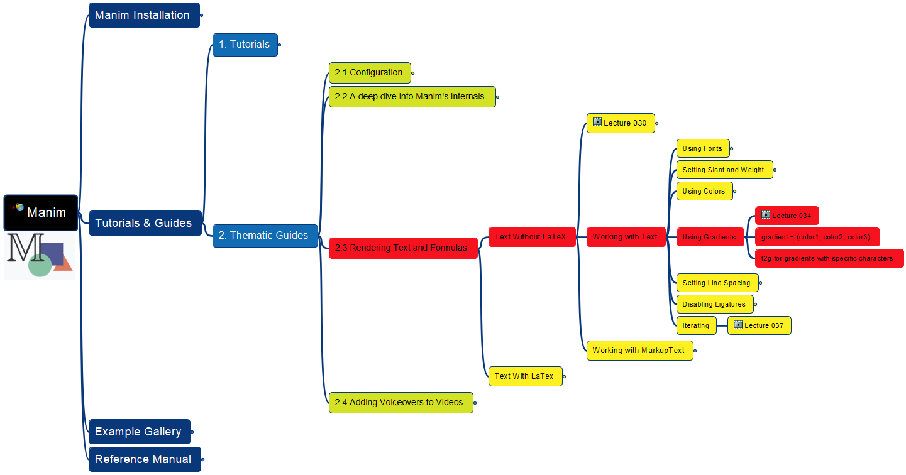
Learning Manim
Thematic Guides – Rendering Text and Formulas – Text Without LaTeX – Text – Using Gradients
034

Slide 36


Learning Manim
Thematic Guides – Rendering Text and Formulas – Text Without LaTeX – Text – Setting Line Spacing
035

Slide 37


Learning Manim
Thematic Guides – Rendering Text and Formulas – Text Without LaTeX – Text – Disabling Ligatures
036

Slide 38


Learning Manim
Thematic Guides – Rendering Text and Formulas – Text Without LaTeX – Text – Iterating
037

Slide 39

Learning Manim
Thematic Guides – Rendering Text and Formulas – Text Without LaTeX – MarkupText
038

Slide 40


Learning Manim
Thematic Guides – Rendering Text and Formulas – Text With LaTeX – Overview
039

Slide 41


Learning Manim
Thematic Guides – Rendering Text and Formulas – Text With LaTeX – MathTex
040

Slide 42



Learning Manim
Thematic Guides – Rendering Text and Formulas – Text With LaTeX – Commands and Keyword Arguments
041

Slide 43


Learning Manim
Thematic Guides – Rendering Text and Formulas – Text With LaTeX – Extra LaTeX Packages
042

Slide 44


Learning Manim
Thematic Guides – Rendering Text and Formulas – Text With LaTeX – Substring and Paths (1)
043

Slide 45


Learning Manim
Thematic Guides – Rendering Text and Formulas – Text With LaTeX – Substring and Paths (2)
044

Slide 46


Learning Manim
Thematic Guides – Rendering Text and Formulas – Text With LaTeX – Substring and Paths (3)
045

Slide 47


Learning Manim
Thematic Guides – Rendering Text and Formulas – Text With LaTeX – index_labels
046

Slide 48


Learning Manim
Thematic Guides – Rendering Text and Formulas – Text With LaTeX – Maths Fonts (1)
047

Slide 49


Learning Manim
Thematic Guides – Rendering Text and Formulas – Text With LaTeX – Maths Fonts (2)
048

Slide 50


Learning Manim
Thematic Guides – Rendering Text and Formulas – Text With LaTeX – Aligning Formulae
049

Slide 51

Learning Manim
Thematic Guides – Adding Voiceovers to Videos (Introduction)
050

Slide 52

Learning Manim
Opening of Part 2
051

Slide 53


Learning Manim
Example Gallery – Basic Concepts – ManimCELogo
052

Slide 54


Learning Manim
Example Gallery – Basic Concepts – BraceAnnotation
053

Slide 55


Learning Manim
Example Gallery – Basic Concepts – VectorArrow
054

Slide 56


Learning Manim
Example Gallery – Basic Concepts – GradientImageFromArray
055

Slide 57


Learning Manim
Example Gallery – Basic Concepts – BooleanOperations
056

Slide 58


Learning Manim
Example Gallery – 2. Animations – 2.1 Point Moving On Shapes
057

Slide 59


Learning Manim
Example Gallery – 2. Animations – 2.2 Moving Around
058

Slide 60


Learning Manim
Example Gallery – 2. Animations – 2.3 Moving Angle
059

Slide 61


Learning Manim
Example Gallery – 2. Animations – 2.4 Moving Dots
060

Slide 62


Learning Manim
Example Gallery – 2. Animations – 2.5 Moving Group To Destination
061

Slide 63


Learning Manim
Example Gallery – 2. Animations – 2.6 Moving Frame Box
062

Slide 64


Learning Manim
Example Gallery – 2. Animations – 2.7 Rotation Updater
063

Slide 65


Learning Manim
Example Gallery – 2. Animations – 2.8 Point With Trace
064

Slide 66


Learning Manim
Example Gallery – 3. Plotting
– 3.1 Sin and Cos Function Plot
065

Slide 67


Learning Manim
Example Gallery – 3. Plotting
– 3.2 Arg Min Example
066

Slide 68



Learning Manim
Example Gallery – 3. Plotting
– 3.3 Graph Area Plot
067

Slide 69


Learning Manim
Example Gallery – 3. Plotting
– 3.4 Polygon On Axes
068

Slide 70


Learning Manim
Example Gallery – 3. Plotting
– 3.5 Heat Diagram Plot
069

Slide 71


Learning Manim
Example Gallery – 4. Special Camera Setting
– 4.1 Following Graph Camera
070

Slide 72


Learning Manim
Example Gallery – 4. Special Camera Setting
– 4.2 Moving Zoomed Scene Around
071
contributed by TheoremofBeethoven

Slide 73


Learning Manim
Example Gallery – 4. Special Camera Setting
– 4.3 Fixed In Frame Mobject Test
072

Slide 74


Learning Manim
Example Gallery – 4. Special Camera Setting
– 4.4 Three-D Light Source Position
073

Slide 75


Learning Manim
Example Gallery – 4. Special Camera Setting
– 4.5 Three-D Camera Rotation
074

Slide 76


Learning Manim
Example Gallery – 4. Special Camera Setting
– 4.6 Three-D Camera Illusion Rotation
075

Slide 77


Learning Manim
Example Gallery – 4. Special Camera Setting
– 4.7 Three-D Surface Plot
076

Slide 78


Learning Manim
Example Gallery – 5. Advanced Projects
– 5.1 Opening Manim
077

Slide 79


Learning Manim
Example Gallery – 5. Advanced Projects
– 5.2 Sine Curve Unit Circle
078
contributed by heejin_park

Slide 80





Learning Manim
Reference Manual - Opening
079

Slide 81


Learning Manim
Reference Manual – 1. Animations
1.01 animation
080

Slide 82


Learning Manim
Reference Manual – 1. Animations
1.01 animation – 1.01.01 Add (1)
081

Slide 83


Learning Manim
Reference Manual – 1. Animations
1.01 animation – 1.01.01 Add (2)
082

Slide 84


Learning Manim
Reference Manual – 1. Animations
1.01 animation – 1.01.02 Animation (1)
083

Slide 85


Learning Manim
Reference Manual – 1. Animations
1.01 animation – 1.01.02 Animation (2)
084

Slide 86


Learning Manim
Reference Manual – 1. Animations
1.02 changing – 1.02.01 AnimatedBoundary
085

Slide 87


Learning Manim
Reference Manual – 1. Animations
1.02 changing – 1.02.02 TracePath (1)
086

Slide 88


Learning Manim
Reference Manual – 1. Animations
1.02 changing – 1.02.02 TracePath (2)
087

Slide 89


Learning Manim
Reference Manual – 1. Animations
1.03 composition – 1.03.02 Lagged Start
088

Slide 90


Learning Manim
Reference Manual – 1. Animations
1.03 composition – 1.03.03 LaggedStartMap
089

Slide 91


Learning Manim
Reference Manual – 1. Animations
1.03 composition – 1.03.04 Succession
090

Slide 92


Learning Manim
Reference Manual – 1. Animations
1.04 creation – 1.04.03 Create
091

Slide 93


Learning Manim
Reference Manual – 1. Animations
1.04 creation – 1.04.04 DrawBorderThenFill
092

Slide 94


Learning Manim
Reference Manual – 1. Animations
1.04 creation – 1.04.06 ShowIncreasingSubsets
093

Slide 95


Learning Manim
Reference Manual – 1. Animations
1.04 creation – 1.04.09 Spiralln
094

Slide 96


Learning Manim
Reference Manual – 1. Animations
1.04 creation – 1.04.10 TypeWithCursor
095

Slide 97


Learning Manim
Reference Manual – 1. Animations
1.04 creation – 1.04.11 Uncreate
096

Slide 98


Learning Manim
Reference Manual – 1. Animations
1.04 creation – 1.04.12 UntypeWithCursor
097

Slide 99


Learning Manim
Reference Manual – 1. Animations
1.04 creation – 1.04.13 Unwrite
098

Slide 100


Learning Manim
Reference Manual – 1. Animations
1.04 creation – 1.04.14 Write
099

Slide 101


Learning Manim
Reference Manual – 1. Animations
1.05 fading
100

Slide 102


Learning Manim
Reference Manual – 1. Animations
1.05 fading – 1.05.01 FadeIn
101

Slide 103


Learning Manim
Reference Manual – 1. Animations
1.05 fading – 1.05.02 FadeOut
102

Slide 104


Learning Manim
Reference Manual – 1. Animations
1.06 growing
103

Slide 105





Slide 107





Slide 108





